Slide 1
Advanced Front-End Programming (CPAN 144)
Week 8
Lecturer: Harshdeep Singh
Summer 2024

Slide 2
Agenda
Handling and rendering lists
Prop Drilling
Lifting State

Slide 3
Rendering Lists
You can use JavaScript’s array methods such as map() and filter() to render an array of data in react.
You can use a component as a template to render each array item.
This promotes reusability as you will be using the same component to display any number of items in the list.

Slide 4
Example
export default function App() {
const cars = [
{ name: "Honda", price: 35000 },
{ name: "Tesla", price: 40000 },
{ name: "Toyota", price: 50000 }
];
return (
<div>
{cars.map((item) => (
<div
style={{
border: "0.1em solid red",
padding: "0.5em",
margin: "0.2em"
}}
>
<div>{item.name}</div>
<div>{item.price}</div>
</div>
))}
</div>
);
}
cars is an array of objects.
JavaScript provides a map() method for arrays, and this allows us to map each item in the array to an element.
Remember that mapping takes place in curly braces {}.

Slide 5
What is Prop Drilling?
Prop drilling refers to passing data and properties from a parent component to its nested children.
Prop drilling allows the components to access and use the objects and data provided by parent/ancestor components that would otherwise be inaccessible to the child components.

Slide 6
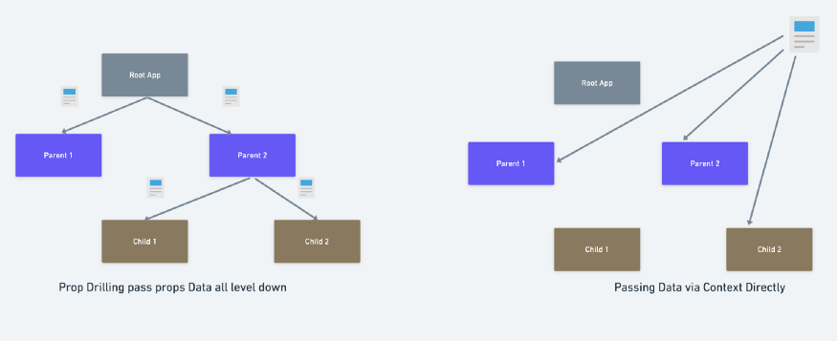
Prop Drilling Illustration

Slide 7
Example
In this example we want to pass down a method from a parent component to it is grand-children.

Slide 8
Example – Continued
export default function App() {
const mySharedMethod = () => {
alert("Yay, It works!");
};
return (
<div className="App">
<ButtonsContainer sharedMethod={mySharedMethod} />
</div>
);
}
mySharedMethod is an arrow function which we want to pass down to a button component.
We pass it down as a prop called sharedMethod to the ButtonsContainer component.

Slide 9
Example – Continued
function ButtonsContainer(props) {
return (
<div>
<Button sharedMethod={props.sharedMethod} />
<Button sharedMethod={props.sharedMethod} />
<Button sharedMethod={props.sharedMethod} />
<Button sharedMethod={props.sharedMethod} />
</div>
);
}
sharedMethod prop is received from the App component and is passed down to the child component Button.

Slide 10
Example – Continued
function Button(props) {
return (
<div>
<button onClick={props.sharedMethod}>Custom</button>
</div>
);
}
sharedMethod prop is received from the ButtonsContainer component and is finally assigned to the onClick event handler of the button element.

Slide 11
Example – Continued
Now, let’s put our components together and see the result.
You can find the full example at Props Drilling - CodeSandbox

Slide 12
What is State Lifting?
State lifting or lifting state up is commonly used to allow children of a common ancestor component access to the same state data.
It is a pattern and not a library or package.
It is especially useful for components to pass data to each other and reflect the same data.

Slide 13
Example
Now consider a scenario where we want to add a pet name and its age to an array of pets. [{name:"Sky",age:4},{name:"Chili",age:6}]
We need a component called RegisterPet. This component should allow us to add new entries to an array of pets.
We also need a component called Pets that specifically displays the list of pets in HTML format.

Slide 14
Example – Continued
export default function App() {
const [pets, setPets] = useState([]);
return (
<div className="App">
<Pets petsList={pets} />
<RegisterPet petsArray={pets} setPetsFunction={setPets} />
</div>
);
}
As you can see, the App component is passing its pets state variable and setPets update function to the RegisterPet component.
This allows the Register pet to access and manipulate the state within the parent (App) component

Slide 15
Example – Continued
function Pets(props) {
return (
<div>
<div>A total of {props.petsList.length} pets have been registered</div>
{props.petsList.map((pet) => (
<div>
{pet.name} is {pet.age} years old
</div>
))}
</div>
);
}
Pets component now makes use of the petsList props that it received from the App component to display it in HTML and also print the total number of pets registered in the system.

Slide 16
Example – Continued
function RegisterPet(props) {
const [petName, setPetName] = useState([]);
const [petAge, setPetAge] = useState([]);
return (
<div>
<div>
<label for="pet_name">Name:</label>
<input
id="pet_name"
value={petName}
onChange={(e) => {
setPetName(e.target.value);
}}
/>
</div>
<div>
<label for="pet_age">Age:</label>
<input
id="pet_age"
value={petAge}
onChange={(e) => {
setPetAge(e.target.value);
}}
/>
</div>
<div>
<button
onClick={() => {
props.setPetsFunction([
...props.petsArray,
{ name: petName, age: petAge }
]);
setPetName("");
setPetAge("");
}}
>
Register
</button>
</div>
</div>
);
}
RegisterPet component now uses the setPetsFunction props it received from the App component to update the pets array.
Notice the use of the spread operator in the onClick handler of the Register button.

Slide 17
Example – Continued
Now, let’s put our components together and see the result.
You can find the full example at State Lifting Example - CodeSandbox

Slide 18
Submit your class Activities
Navigate to Course Content -> Assessments -> Labs -> Lab 7 and download the instruction for lab 7.
Once you fulfill all the requirements of the lab, ZIP all your source files and submit them into Course Content -> Assessments -> Labs -> Lab 7
Pay attention to the due date defined on the blackboard submission box for this activity.

